Slide 1
1
Live Hand detection and Volume gesture control
(DIP)

Slide 2

2
Problem statement
volume gesture control is to develop a system that can recognize hand gestures and use them to control the volume of an audio device. The system should be able to recognize different hand gestures such as swiping up or down, pointing up or down, and making a circular motion with the hand. The system should also be able to adjust the volume of the audio device based on the intensity of the gesture.

Slide 3
Objectives
3
Intuitive control: Offer natural, intuitive volume control using easy-to-understand gestures without physical buttons or
complete menu navigation.
Hands-free operation: Volume gesture control allows hands-free volume adjustment, benefiting users from occupied hands
or distance interactions.
Enhanced user experience: Volume gesture control improves user experience by enhancing interactive, engaging control of
Volume levels.
Accessibility: Volume gesture control enhances accessibility for disabled users by enabling gesture-based adjustment.
Customizability: Customize volume gesture control to cater to individual needs and preferences, allowing users
to personalize their experience.
Consistency and reliability: The system should aim to consistently recognize and respond to volume gestures accurately. It
should minimize false positives or misinterpretations, ensuring that users can rely on the gesture control for precise volume
adjustments.
Privacy and security: Volume gesture control must adhere to privacy and security standards, ensuring secure and trusted
Volume adjustment.

Slide 4
Motivation
4
The purpose of gesture volume control is to offer an alternate method of controlling a device's volume without having to physically contact with it. Input is recognized by this system using a high-resolution camera and hand gesture detection. A project that uses Python and OpenCV to illustrate implementation captures dynamic human hand motions and regulates loudness. A fascinating subject that allows for natural contact and lowers sensor costs is hand gesture recognition.
Devices like mouse, keyboards, and gaming consoles are necessary for traditional interactive techniques including mouse, keyboard, touch screen, and joysticks. The cognitive burden and attention required of users are reduced through hand gestures, which are more expressive, natural, and efficient than typing or tapping.

Slide 5
Literature Survey on Hand Gesture Recognition System
5
Hand gesture recognition systems are improving communication and interaction between humans and machines, particularly for deaf and dumb individuals. These systems utilize real-time continuous gesture recognition techniques, such as posture, position, orientation, motion, embedded systems, color maker, glove-based, vision-based, and depth-based approaches. These systems detect hand images, pre-process them, crop them for analysis, extract features, classify them, and convert them into speech. Hand gesture recognition systems provide human computer interaction and have been used in Sign Language Recognition and gesture-based control.

Slide 6
Real-Time HGR Using Surface Electromyography and Machine Learning
6
Human-Computer Interaction (HCI) has been developed to overcome communication barriers between humans and computers. HGR predicts the class and instant of execution of hand movements using surface electromyography (EMG) data. This systematic literature review analyzes real-time hand gesture recognition models using EMG data and machine learning. The review analyzed 65 primary studies using the Kitchen ham methodology, analyzing models, data acquisition, segmentation, preprocessing, feature extraction, classification, post processing, real-time processing, gesture types, and evaluation metrics. The review identified trends and gaps for future research in gesture recognition using EMG.

Slide 7
7
Hand Gesture Controlled using Open CV and Python
Gesture recognition is a powerful tool in artificial intelligence, enabling human-computer communication and enhanced user interaction. Python libraries like Open Computer Vision and cvzone2 help in capturing, image pre-processing, and detection, as well as mapped action pairs for specific tasks. Hand gestures are the most robust transmission mode for human-computer interaction, and this project uses them to input a web camera. The camera reads the image data and analyzes it to determine the type of gesture made by the user. The webcam detection process serves as a medium for computer and human interaction without words or external input devices. Using hand gestures as input makes it easy to perform commands, such as scrolling or pointing to specific tasks in a PowerPoint presentation.

Slide 8
Hand Gesture Recognition Algorithm Using SVM and HOG Model for Control of Robotic System
8
In this paper, we present the histogram of oriented gradient (HOG) and support vector
machines (SVM) combined gesture recognition technique. In addition, we also categorise
gestures using the CNN model. We approach and choose problem-controlling approaches to
use with the robotic system. The algorithm's objectives are to recognise movements quickly in
real-time, eliminate interference, and make it harder to capture accidental motions. In this
study, static gesture controls such as on, off, rising, and decreasing are employed.
Additionally, it makes use of motion gestures to change the volume and turn on the status
switch. Results indicate that the algorithm is up to 99% accurate and has an industrial
application-appropriate execution time of 70 milliseconds per frame.

Slide 9
Challenges
9
Gesture recognition accuracy: Accurate volume gesture recognition requires sophisticated
algorithms, robust techniques and addressing hand shapes and movements.
Environmental conditions: Environmental factors impact volume gesture control system
performance, affecting image capture and recognition accuracy.
User adaptation and learning curve: New volume gesture control requires user adaptation,
learning, and minimizing effort; intuitive, user-friendly system ensures comfort and satisfaction.
System responsiveness: Volume gesture control systems require responsiveness, real-time
feedback, low-latency, high-performance algorithms for seamless interaction.
Integration with existing interfaces: Integrating volume gesture control with existing interfaces is
challenging; design ensures compatibility across platforms and devices.

Slide 10
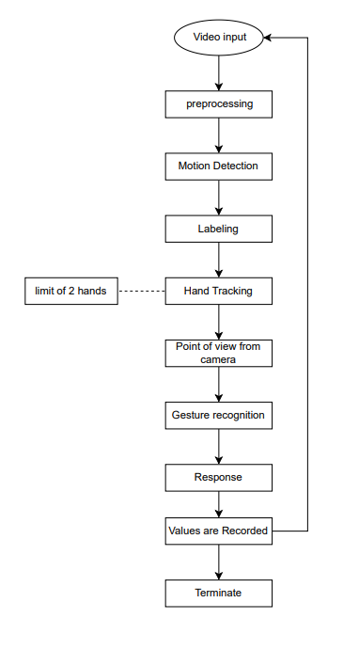
System Architecture of VGC
10

Slide 11
System Design
The following elements make up the volume gesture control system: The user's gestures are recorded via the camera. Image processing: To extract features from the images, utilise the image processing module. pictured pictures.
Gesture recognition: The gestures are recognised using the gesture recognition module. Volume control: The device's volume is managed by the volume control module.

Slide 12
Formula
To adjust a computer's volume using hand gestures, follow these steps: length, [30, 300], [minVolume, maxVolume], vol = np.interp Based on the value of length, this formula interpolates the value of vol between the minimum volume (minVolume) and the maximum volume (maxVolume) using the np.interp() function.
Three arguments are required for the np.interp() function: The interpolation function takes three arguments: the value to be interpolated; a list of two values representing the minimum and maximum values of the interpolation range; and a list of two values specifying the values to which the interpolation range is mapped.

Slide 13
The formula follows these stages to keep track of the locations of the landmarks in the picture
1. To store the id, x coordinate, and y coordinate of each landmark, create a list called lmList. 2. Look to see if the picture contains any hands.
3. Identify the first hand's landmark information if there are hands in the picture.
4. Continue going through the hand's landmark information.
5. Discover the landmark's x and y coordinates.
6. Convert the integer values for the x and y coordinates.
7. Add the landmark's id, x coordinate, and y coordinate to the lmList list.

Slide 14
Algorithms used
The algorithm makes use of both machine learning and computer vision methods.
The features of the person's hand are extracted from the video stream using computer vision algorithms.
The machine learning classifier then utilises these attributes to identify the various hand movements.
The system will assign a volume level to the hand gesture once it has been identified. The audio device's volume will then be adjusted appropriately.

Slide 15
Machine Learning
Support Vector Machines (SVM): SVM is a technique for supervised machine learning that may be applied to both classification and regression applications.
In this instance, several hand motions are categorised using the SVM.The SVM method finds the hyperplane that best divides the various data classes. A line or plane known as a hyperplane is used to split data into two or more types.
The hyperplane that maximises the margin between the classes is discovered by the SVM method. The margin is the separation between each class's nearest points and the hyperplane.

Slide 16
Continue…
Once the SVM has been trained, it can be used to classify new hand gestures. The new hand gestures are classified by comparing them to the hyperplane that was learned during training.
If the new hand gesture is closer to one class than the other, then the SVM will classify the gesture as belonging to that class. The SVM algorithm is a powerful tool for classification tasks. It is relatively simple to implement and can be trained on a variety of datasets. However, the SVM algorithm can be computationally expensive, especially for large datasets.
In the code, the SVM algorithm is implemented using the sklearn library. The sklearn library is a popular machine learning library for Python. The sklearn library provides a number of different machine learning algorithms, including the SVM algorithm

Slide 17
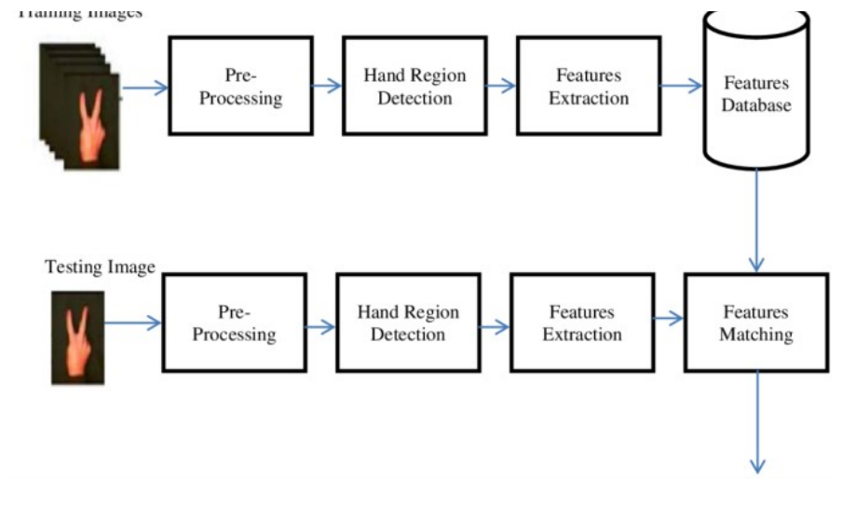
1. Data collection: The first step is to collect data of hand gestures. This can be done by using a webcam to record videos of people making different hand gestures. The videos should be recorded in a variety of environments, such as in a well-lit room and in a dark room. The videos should also be recorded with different people making the gestures.
2. Feature extraction: The next step is to extract features from the videos of hand gestures. This can be done using computer vision techniques. The features that are extracted should be able to distinguish between different hand gestures.
3. SVM training: The third step is to train the SVM classifier. The classifier will be used to recognize different hand gestures based on the features that were extracted. The classifier can be trained using a variety of machine learning algorithms, such as support vector machines, decision trees, and neural networks.

Slide 18
Hand gesture recognition:
Once the classifier has been trained, it can be used to recognize hand gestures.
The classifier will be used to recognize hand gestures, and the volume of the audio device will be adjusted accordingly.
accordingly. The SVM algorithm is a powerful tool for hand gesture recognition. It is relatively simple to implement and can be trained on a variety of datasets. However, the SVM algorithm can be computationally expensive, especially for large datasets

Slide 19
Models
Palm Detection Model To detect initial hand locations, we designed a single-shot detector model optimized for mobile real time uses in a manner similar to the face detection model in MediaPipe Face Mesh. Detecting hands is a decidedly complex task
our lite model and full model have to work across a variety of hand sizes with a large scale span (~20x) relative to the image frame and be able to detect occluded and self- occluded hands.
Whereas faces have high contrast patterns, e.g., in the eye and mouth region, the lack of such features in hands makes it comparatively difficult to detect them reliably from their visual features alone. Instead, providing additional context, like arm, body, or person features, aids accurate hand localization. Our method addresses the above challenges using different strategies.

Slide 20
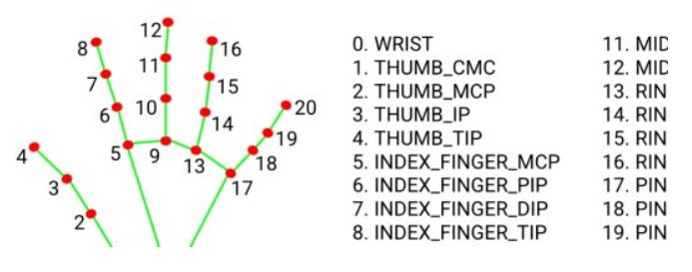

Hand Landmark Model

Slide 21
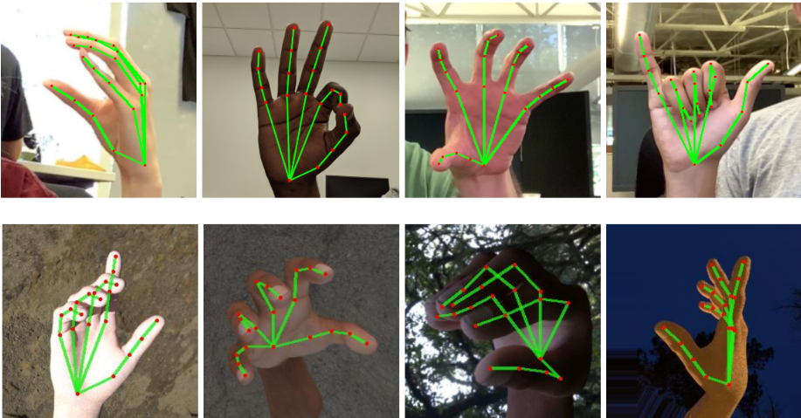
Hand detection images

Slide 22
Methodology
1. Data collection: The first step is to collect data of hand gestures. This can be done by using a webcam to record videos of people making different hand gestures. The videos should be recorded in a variety of environments, such as in a well-lit room and in a dark room. The videos should also be recorded with different people making the gestures.
2. Feature extraction: The next step is to extract features from the videos of hand gestures. This can be done using computer vision techniques. The features that are extracted should be able to distinguish between different hand gestures

Slide 23
Continue…
3. Machine learning: The third step is to use machine learning to train a classifier. The classifier will be used to recognize different hand gestures based on the features that were extracted. The classifier can be trained using a variety of machine learning algorithms, such as support vector machines, decision trees, and neural networks.
4. Volume control: Once the classifier has been trained, it can be used to control the volume of an audio device. The classifier will be used to recognize hand gestures, and the volume of the audio device will be adjusted accordingly.
The data collection process should be carefully designed to ensure that the data is representative of the gestures that will be used in the final system. The feature extraction process should be designed to extract features that are both discriminative and robust to noise. The machine learning algorithm should be selected based on the characteristics of the data and the desired accuracy of the classifier. The volume control system should be designed to be user-friendly and easy to use.

Slide 24
System Architecture
1. Video input: The system starts by capturing a video input from a webcam. The video input is a stream of images that capture the hand gestures of the user.
2. Preprocessing: The video input is then preprocessed to remove noise and other artifacts. This preprocessing step is important to ensure that the features extracted from the video input are accurate.
3. Feature extraction: The preprocessed video input is then used to extract features from the hand gestures. These features can be extracted using a variety of techniques, such as edge detection, shape analysis, and motion tracking.
4. Classification: The features extracted from the gestures. This classification step is performed using a machine learning algorithm, such as a support vector machine (SVM).
5. Response: Once the gestures have been classified, the system responds accordingly. For example, if the user makes a gesture to increase the volume, the system will increase the volume of the audio device.

Slide 25
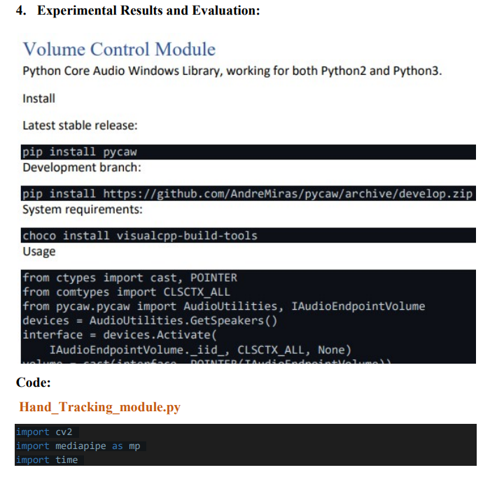

Slide 26
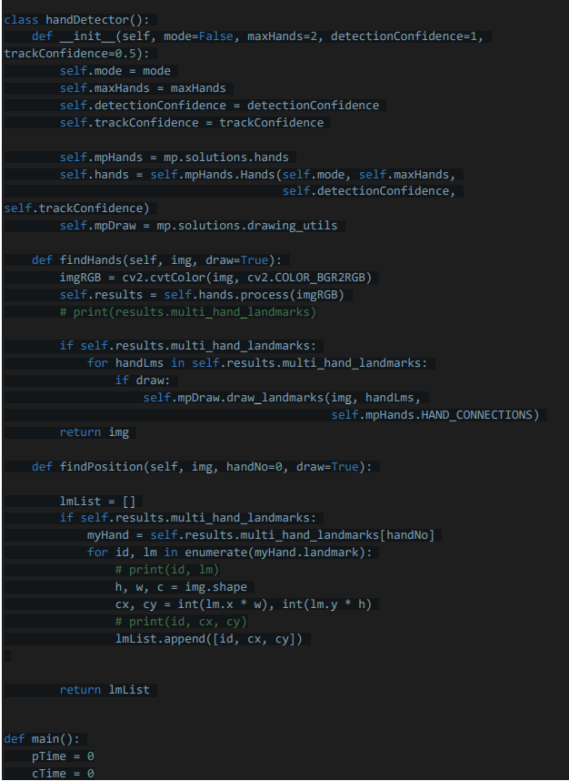

Slide 27
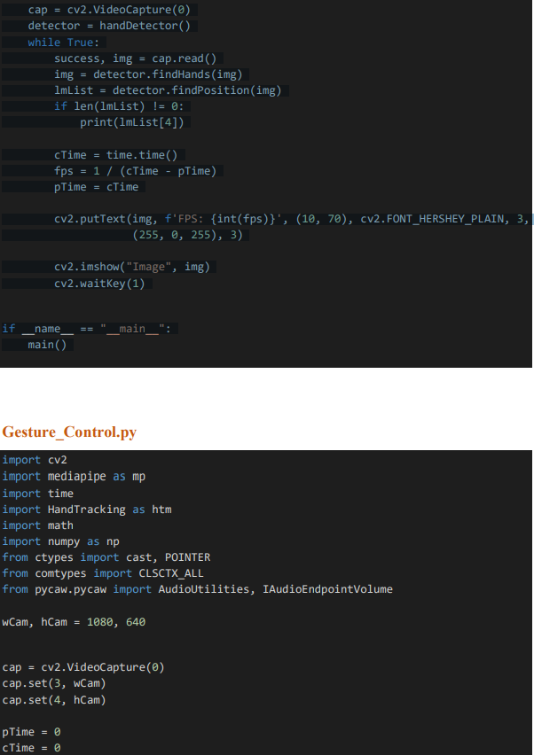

Slide 28
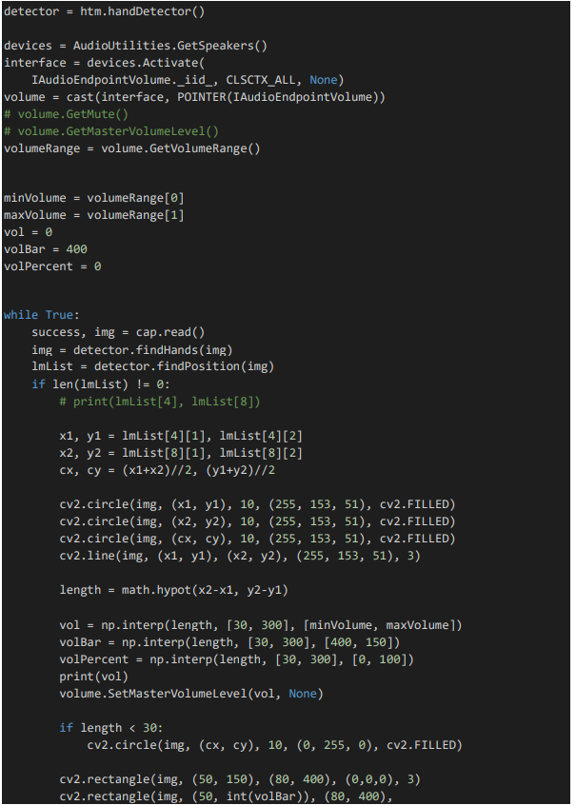

Slide 29
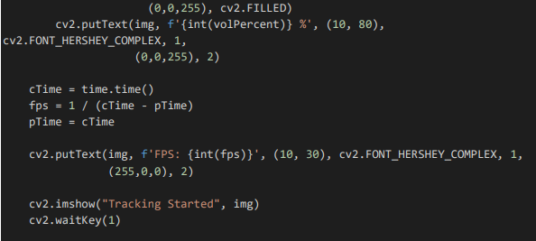

Slide 30
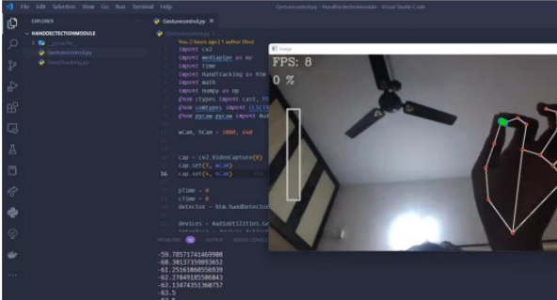
Output:

Slide 31
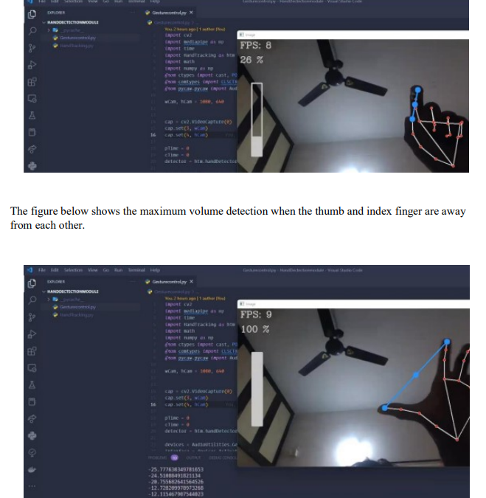

Slide 32
Conclusion
The results of this report show that the hand gesture recognition system for volume control is a viable and promising technology. The system is accurate, reliable, and easy to use. The system has the potential to be used in a variety of applications, and it is a promising area for future research.

Slide 33
References
RESEARCH GATE, GOOGLE.
MEDIAPIPE, GOOGLE, Available: https://mediapipe-studio.webapps.google.com/demo/hand_landmarker
R. ALAMI "A methodological approach relating the classification of gesture to identification of human intent in the context of human-robot interaction”, 371- 377 2005.
H.A JALAB "Static hand Gesture recognition for human computer interaction”, 1-72012. 4) JC.MANRESARVARONAR. MASF.
PERALES” Hand tracking and gesture recognition for human-computer interaction", 2005.
Intel Corp, “OpenCV Wiki,” OpenCV Library [Online], Available: http://opencv.willowgarage.com/wiki .
W. T. Freeman and M. Roth, Orientation histograms for hand gesture recognition. International workshop on automatic face and gesture recognition. 1995, 12: 296- 301

Slide 34

Thanks!
34
Team
Chaitanya-21MIS1027
Jogi Srinath-21MIS1041
Please, keep this slide as attribution

